Slide 1

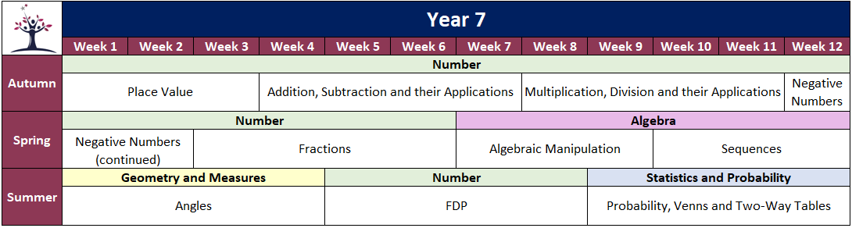
Name
Class
Tutor Group
YEAR 7 MATHEMATICS
Retrieval Booklet
Half Term 1
Content | Page
HT1 Retrieve & Retain Starters | 2
N1: Place Value - Knowledge Organiser | 6
N1: Place Value - Knowledge Organiser Quiz | 7
N1: Place Value - End of Booklet Review | 8
N1: Place Value - End of Booklet Follow Up Qs | 13
N2: Addition, Subtraction and their Applications - Knowledge Organiser | 20
N2: Addition, Subtraction and their Applications - Knowledge Organiser Quiz | 21
N2: Addition, Subtraction and their Applications - End of Booklet Review | 22
N2: Addition, Subtraction and their Applications - End of Booklet Follow Up Qs | 31

Slide 2
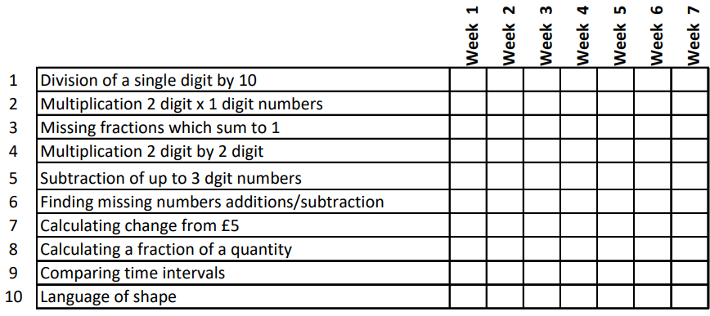
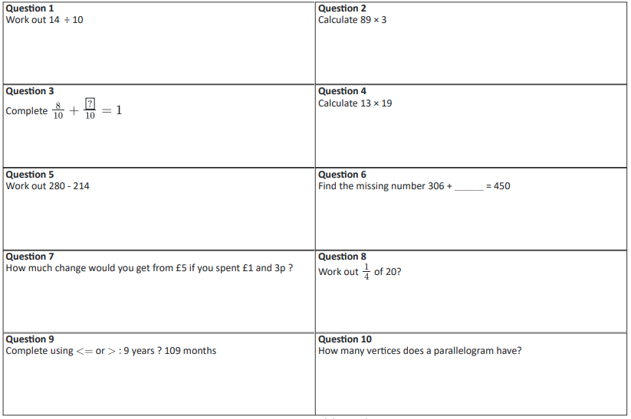
Cumulative R&R: Retrieve & Retain
Week 1

Slide 3
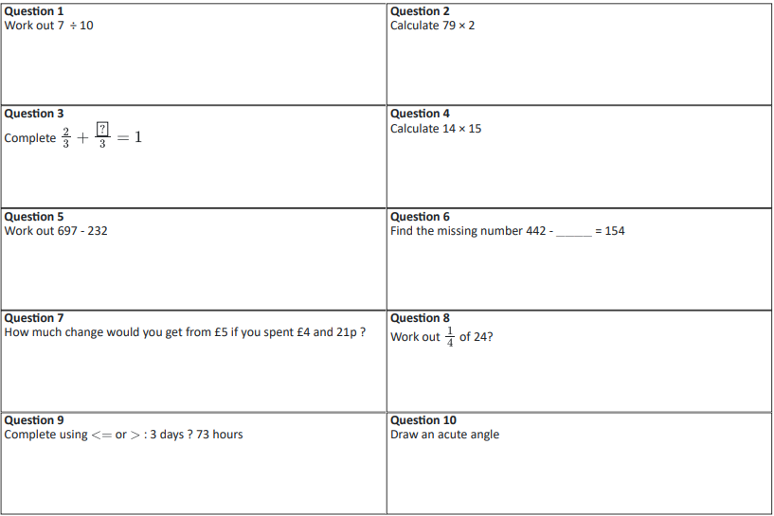
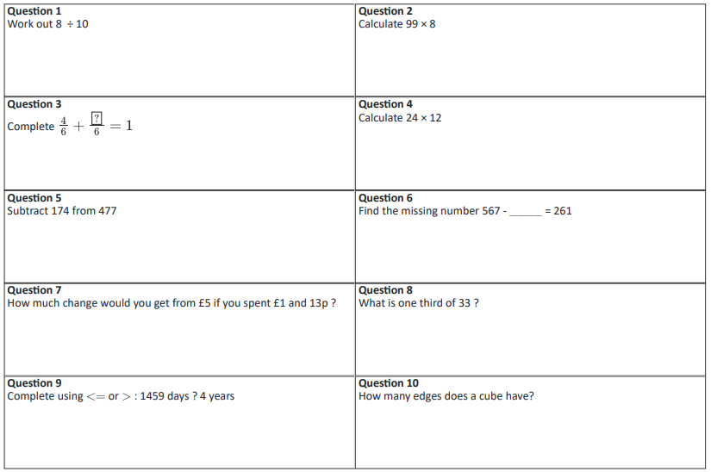
Week 2
Week 3

Slide 4
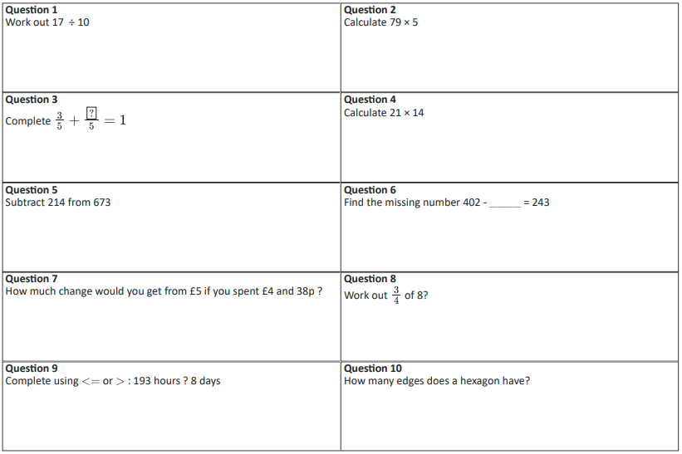
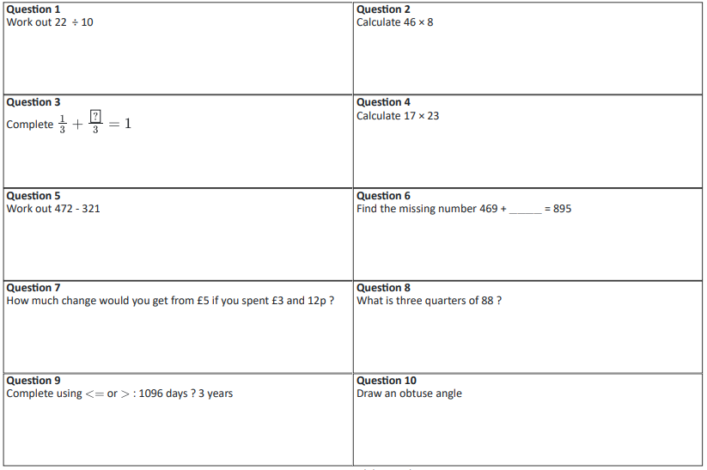
Week 4
Week 5

Slide 5

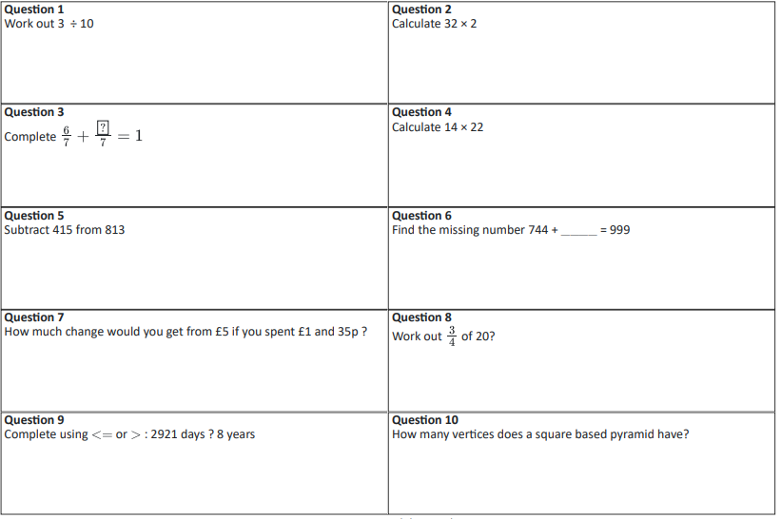
Week 6
Week 7

Slide 6
N1 Place Value
Knowledge Organiser
​ | Knowledge​ | Answer​
1​ | What is an integer?​ | A whole number, positive or negative.​
2​ | What is a digit?​ | Any of the numerals 0-9 used to form a number​
3​ | What are positive numbers?​ | Numbers to the right of 0 on a number line.​
4​ | What is an inequality?​ | A relationship where two values are not equal.​
5​ | What are decimals?​ | Numbers between whole numbers, expressed with a decimal point.​
6​ | What are negative numbers?​ | Numbers to the left of 0 on a number line.​
7​ | What is rounding?​ | Approximating a number to a given level of accuracy.​
8​ | What is the median of a data set?​ | The middle value of an ordered list.​
9​ | What are powers?​ | A way of expressing repeated multiplication of a number.​
10​ | What is standard form?​ | A number written as , where 1 ≤ a < 10, and n is an integer.​
11​ | What is binary?​ | A number system using only 0 and 1.​

Slide 7
N1 Place Value
Knowledge Organiser Quiz
​ | Knowledge​ | Answer​
1​ | What is an integer?​
2​ | What is a digit?​
3​ | What are positive numbers?​
4​ | What is an inequality?​
5​ | What are decimals?​
6​ | What are negative numbers?​
7​ | What is rounding?​
8​ | What is the median of a data set?​
9​ | What are powers?​
10​ | What is standard form?​
11​ | What is binary?​

Slide 8

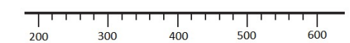
N1 Place Value
End of Booklet Review
a) Write down the value of 6 in 5369
b) Write down the value of 6 in 260,000
c) Write down the value of 6 in 62,000,000
a) Write down the number three hundred and nine in figures
b) Write down the number nine billion in figures
c) Write down the number seventy two thousand, eight hundred and six in figures
3. Here are 4 digits 5 1 4 8
The digits can be arranged to make other numbers.
Write down the largest number that can be made
Write down the smallest number that can be made
Write down the smallest three digit number that can be made
4. a) Write down the number marked by the arrow on the number line below
b) Mark the number 440 on the number line below.
5. a) ? > 6. Circle the numbers that ? could be.
3 9 8 6 7
b) ? ≤ 5. Circle the numbers that ? could be.
5 6 3 0 7

Slide 9


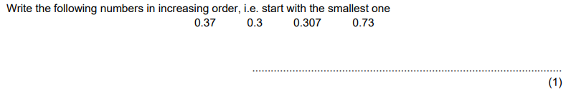
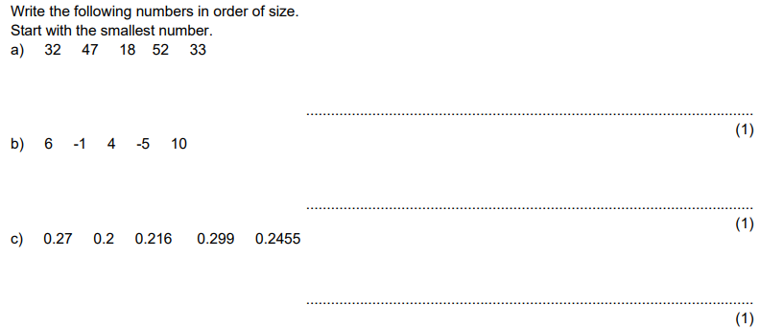

N1 Place Value
End of Booklet Review
6. Write the following numbers in order of size, starting with the smallest number.
a) 32 47 18 52 33
b) 132 470 1080 52 1062
7. Insert the correct symbol, <, >, ≤, ≥, = or ≠ between each pair of numbers:
a) 6.438 6.51 b) 0.78 0.705
8.
9.
10.

Slide 10

N1 Place Value
End of Booklet Review
11. a) Round 3289 correct to the nearest thousand
b) Write 104.735 to the nearest 100
c) Round 6.45 to the nearest integer
12. a) Write 104.735 correct to 2 decimal places
b) Round 105.735 correct to 1 decimal place
c) Write 2.49 correct to 1 decimal place.
a) Write the number 104.735 to 3 significant figures.
b) 0.05076 to two significant figures.
14.

Slide 11


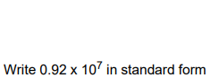


N1 Place Value
End of Booklet Review
15.
16.
17. a) Write the following numbers in standard form:
0.002 ii) 0.006015
b) Write the following numbers in ordinary form:
i) 3 × 10⁻⁶ ii) 4.8 × 10⁻⁴
18.
a) Write the decimal number 55 as a binary number
b) Write the binary number 1011010 as a decimal number

Slide 12
N1 Place Value
End of Booklet Review
Q1 | Q2 | Q3 | Q4 | Q5 | Q6 | Q7 | Q8 | Q9
/3 | /3 | /3 | /2 | /2 | /2 | /2 | /2 | /2
A | B | C | D | E | F | G | H | I
Q10 | Q11 | Q12 | Q13 | Q14 | Q15 | Q16 | Q17 | Q18 | Q19
/2 | /3 | /3 | /2 | /1 | /3 | /1 | /4 | /1 | /2
J | K | L | M | N | O | P | Q | R | S
Complete these sections for the questions you didn’t get full marks on

Slide 13
N1 Place Value
End of Booklet Follow Up Questions
Section A
a) Write down the value of 7 in 5379
b) Write down the value of 7 in 5739
c) Write down the value of 7 in 5937
d) Write down the value of 7 in 570,039
e) Write down the value of 7 in 7,000,000
f) Write down the value of 7 in 8,700,000
Section B
a) Write down the number six hundred and eight in figures
b) Write down the number four hundred and twenty in figures
c) Write down the number one thousand and six in figures
d) Write down the number eight billion in figures
e) Write down the number three billion, five hundred and twelve in figures.
f) Write down the number ninety one thousand, four hundred and thirteen in figures
g) Write down the number sixty seven thousand, four hundred and thirteen in figures

Slide 14
N1 Place Value
End of Booklet Follow Up Questions
Section C
Here are five numbers 7 4 9 6 2
Using no card more than once, write down:
The smallest 5 digit number you can make
The largest 5 digit number you can make
The smallest 4 digit number you can make
The largest 4 digit number you can make
The smallest 3 digit number you can make
The largest 3 digit number you can make
The smallest 2 digit number you can make
The largest 2 digit number you can make
Section D
a) Write down the numbers marked by the arrows on the number lines below
b) Mark the number 360 on the number line below.
c) Mark the number 87 on the number line below.
100
200
300
350
450
80
90
100
500
600
700
80
90
100

Slide 15
N1 Place Value
End of Booklet Follow Up Questions
Section E
a) ? > 7. Circle the numbers that ? could be.
9 8 6 7
b) ? < 7. Circle the numbers that ? could be.
9 8 6 7
c) ? ≤ 7. Circle the numbers that ? could be.
9 8 6 7
d) ? ≥ 7. Circle the numbers that ? could be.
9 8 6 7
Section F
Order these values from largest to smallest
11, 20, 9, 15, 14, 3
83, 18, 45, 37, 90, 21
605, 56, 566, 655, 506, 65, 555
2000, 375, 7100, 2900, 999, 400
18123, 18200, 18032, 18103, 18013
Section G
Insert the correct symbol, <, >, ≤, ≥, = or ≠ between each pair of numbers:
7.2 7.1 b) 0.5 0.6
8.32 8.23 d) 0.59 0.506
e) 1.01 1.1 f) 3.9 3.09
g) 5.834 5.843 h) 62.391 62.0391

Slide 16
N1 Place Value
End of Booklet Follow Up Questions
Section H
a) Write down the numbers marked by the arrows on the number lines below
b) Mark the number 3.6 on the number line below.
c) Mark the number 0.87 on the number line below.
1
2
3
3.5
4.5
0.8
0.9
1
6
7
5
3 4 5
80
0.7 0.9
90
110
Section I
Order from largest to smallest:
9.13, 9.05, 9.24, 9.09, 9.15, 9.02
1.54, 1.49, 1.58, 1.43, 2.12, 0.97
1.3, 1.07, 1.14, 1.6, 1.39
6.25, 6.2, 6.19, 6.08, 6.1, 6.21
7.81, 7.49, 7.9, 7.007, 7.1, 7.107
0.342, 0.075, 0.256, 0.34, 0.6, 0.4

Slide 17
N1 Place Value
End of Booklet Follow Up Questions
Section J
Order from smallest to largest:
3, −5, 1, 0, −2, 4
−2, −8, −3, 5, −6, 1
11, −9, −4, 7, −10, −3, −13
−25, 35, 15, −5, 25, −45, 20
129, 101, −11, −111, 92, −91, 133, −29
Section K
Round 18004 to the nearest
Ten
Hundred
Thousand
Ten thousand
Round 57.835 to the nearest
Ten
Hundred
Integer
Round 1209.0845 to the nearest
Ten
Hundred
Thousand
Integer
Section L
Round 64.50312 to
1dp
2dp
3dp
4dp
Round 28.1793 to
1dp
2dp
3dp
Round 1209.00845 to
1dp
2dp
3dp
4dp

Slide 18
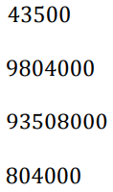
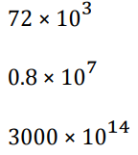

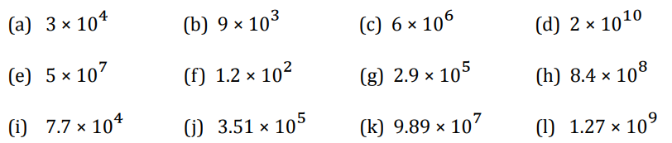
N1 Place Value
End of Booklet Follow Up Questions
Section M
Round 18004 to
1 significant figure
2 significant figures
3 significant figures
4 significant figures
Round 57.835 to
1 significant figure
2 significant figures
3 significant figures
Round 0.80425 to
1 significant figure
2 significant figures
3 significant figures
4 significant figures
Section N
Calculate the median of the following:
605, 56, 566, 655, 506, 65, 555
18123, 18200, 18032, 18103, 18013
1.3, 1.07, 1.14, 1.6, 1.39
2000, 375, 7100, 2900, 999, 400
11, 20, 9, 15, 14, 3
83, 18, 45, 37, 90, 21
11, −9, −4, 7, −10, −3, −13
−25, 35, 15, −5, 25, −45, 20
Section O
Write the following numbers in standard form:
Section P
Write the following numbers in ascending order:
a)
b)
c)

Slide 19
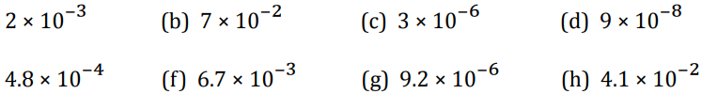


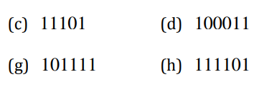
N1 Place Value
End of Booklet Follow Up Questions
Section Q
Write the following numbers in standard form:
Write the following numbers in ordinary form:
Section R
Write the following numbers in descending order:
Section S
Convert the following from decimal to binary numbers
Convert the following from binary to decimal numbers

Slide 20
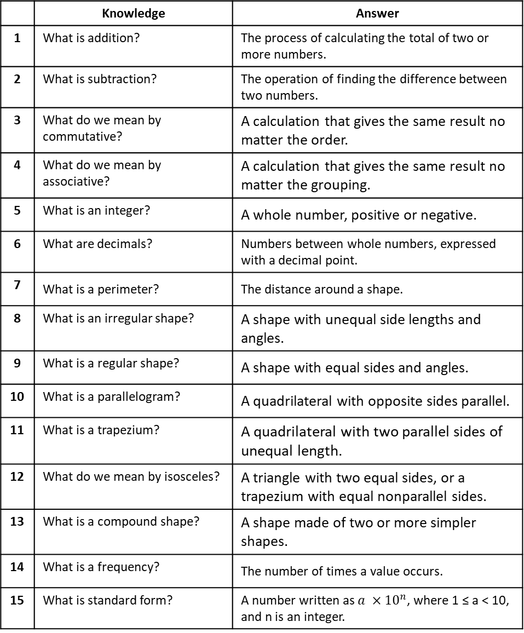
N2 Addition, Subtraction and their Applications
Knowledge Organiser
 | Knowledge | Answer
1 | What is addition? | The process of calculating the total of two or more numbers.
2 | What is subtraction? | The operation of finding the difference between two numbers.
3 | What do we mean by commutative? | A calculation that gives the same result no matter the order.
4 | What do we mean by associative? | A calculation that gives the same result no matter the grouping.
5 | What is an integer? | A whole number, positive or negative.
6 | What are decimals? | Numbers between whole numbers, expressed with a decimal point.
7 | What is a perimeter? | The distance around a shape.
8 | What is an irregular shape? | A shape with unequal side lengths and angles.
9 | What is a regular shape? | A shape with equal sides and angles.
10 | What is a parallelogram? | A quadrilateral with opposite sides parallel.
11 | What is a trapezium? | A quadrilateral with two parallel sides of unequal length.
12 | What do we mean by isosceles? | A triangle with two equal sides, or a trapezium with equal nonparallel sides.
13 | What is a compound shape? | A shape made of two or more simpler shapes.
14 | What is a frequency? | The number of times a value occurs.
15 | What is standard form? | A number written as $a ×{10}^{n}$, where 1 ≤ a < 10, and n is an integer.

Slide 21
N2 Addition, Subtraction and their Applications
Knowledge Organiser Quiz
 | Knowledge | Answer
1 | What is addition?
2 | What is subtraction?
3 | What do we mean by commutative?
4 | What do we mean by associative?
5 | What is an integer?
6 | What are decimals?
7 | What is a perimeter?
8 | What is an irregular shape?
9 | What is a regular shape?
10 | What is a parallelogram?
11 | What is a trapezium?
12 | What do we mean by isosceles?
13 | What is a compound shape?
14 | What is a frequency?
15 | What is standard form?

Slide 22
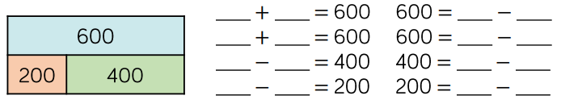
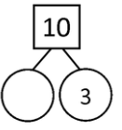
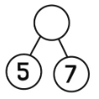
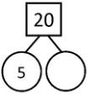
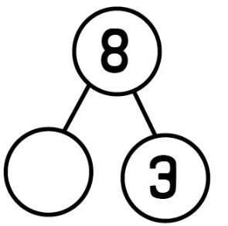
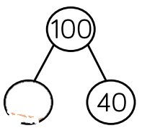




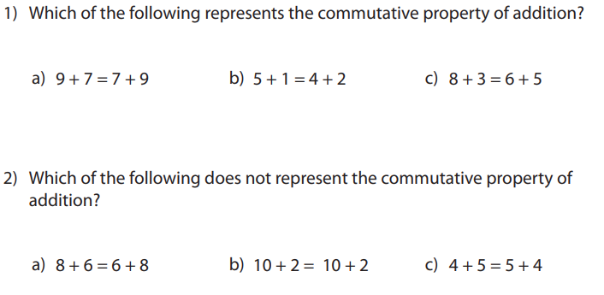
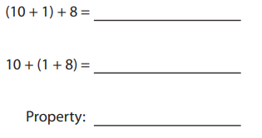
N2 Addition, Subtraction and their Applications
End of Booklet Review
Use the bar model to complete the number sentences:
+
+
Complete the part-whole models:
3.
Which of the following represents the commutative property of addition?
Which of the following does not represent the commutative property of addition?
If 356 + 79 = 435, then 79 + 356 = ______
Complete the following:
(125 + 347) + 88 = 125 + (347 + )

Slide 23

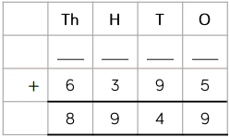
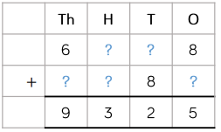
N2 Addition, Subtraction and their Applications
End of Booklet Review
4. Calculate the following:
53 + 41 =
44 + 37 =
85 + 29 =
113 + 49 =
416 + 87 =
f) 817 + 306 =
g) 752 + 489 =
1487 + 336 =
Fill in the missing digits:
Fill in the missing digits:

Slide 24

N2 Addition, Subtraction and their Applications
End of Booklet Review
5. Calculate the following:
5.3 + 4.1 =
44 + 3.7 =
8.5 + 29 =
11.3 + 4.9 =
4.16 + 0.87 =
f) 0.817 + 3.06 =
g) 0.752 + 0.489 =
1.487 + 0.336 =
Fill in the missing digits:
Decide whether each of these are ways to set out 4.38 + 7.9
8
.
.
.

Slide 25
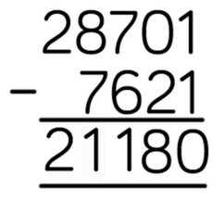
N2 Addition, Subtraction and their Applications
End of Booklet Review
6. Calculate the following:
53 - 41 =
44 - 37 =
85 - 29 =
113 - 49 =
416 - 87 =
f) 817 - 306 =
g) 752 - 489 =
1487 - 336 =
400 – 287 =
1000 – 649 =
Rosie completes this subtraction incorrectly. Explain her mistake and how to correct it.

Slide 26
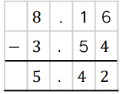
N2 Addition, Subtraction and their Applications
End of Booklet Review
7. Calculate the following:
5.3 – 4.1 =
4.4 – 3.7 =
8.5 – 0.29 =
1.13 – 0.49 =
41.6 – 0.87 =
f) 8.17 – 0.306 =
g) 75.2 – 4.89 =
1 – 0.7 =
1 – 0.46 =
1 – 0.649 =
Spot the mistake:

Slide 27
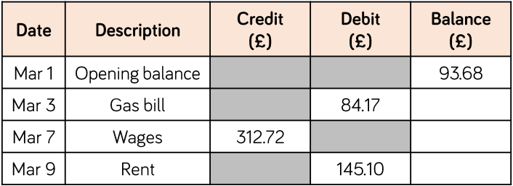
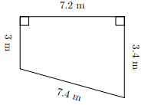
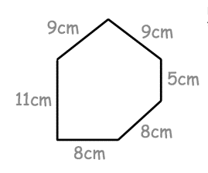
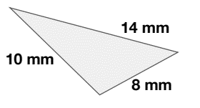
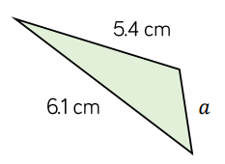
N2 Addition, Subtraction and their Applications
End of Booklet Review
8.
John spends £112.50 on ingredients and £17.80 on advertising for a cake sale. He sells all the cakes for a total of £145.12. Does he make a profit or a loss? How much profit or loss does he make?
Complete the bank statement.
9. Work out the perimeters of each of these irregular polygons:
a) b) c)
d) The perimeter of this shape is 14.2cm. What is the length of the missing side?

Slide 28
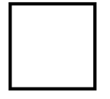
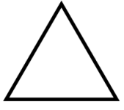
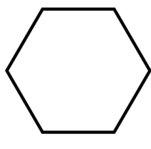
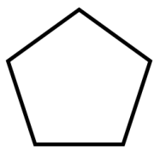

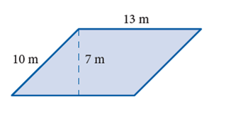
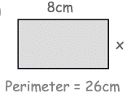
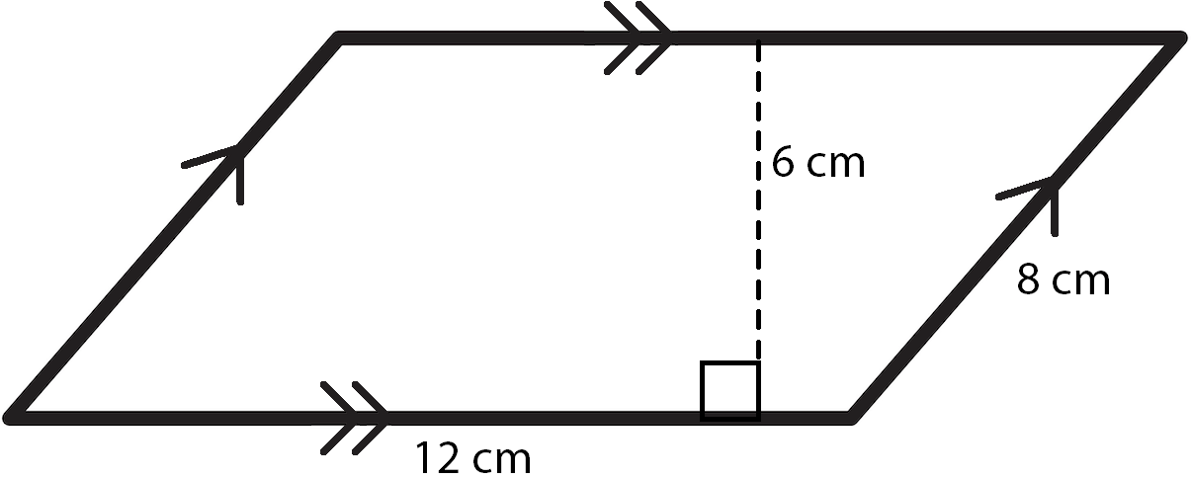
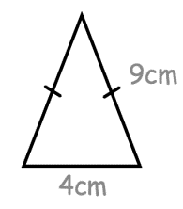
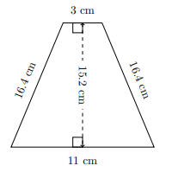
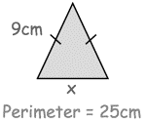
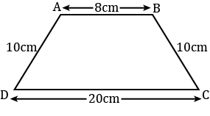
N2 Addition, Subtraction and their Applications
End of Booklet Review
10. Work out the perimeters of each of these regular polygons:
a) b) c)
d) The regular pentagon below has perimeter 35cm. Calculate the length of one side length.
4cm
6cm
8cm
11. Work out the perimeters of each of these rectangles and parallelograms:
a) b) c) d) Calculate the missing side length, x:
13cm
8cm
7cm
10cm
12cm
12. Work out the perimeters of each of these isosceles triangles and isosceles trapezia:
a) b) Calculate the c) d) missing side length, x:
5m
13m
14m
12m

Slide 29
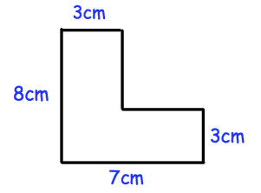
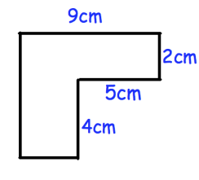
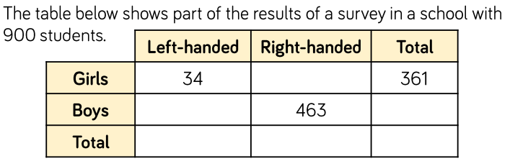
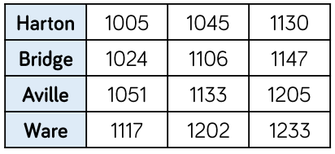

N2 Addition, Subtraction and their Applications
End of Booklet Review
13. Work out the perimeters of each of these compound shapes:
a) b)
14. a) The table below shoes part of the results of a survey in a school with 900 students. Complete the table below:
b) Here is a bus timetable. How long does it take to get to Ware, if you take the 1005 bus from Harton?
15. a) Complete the frequency tree, using the information below:
b) How an more men than women did not pass their test?

Slide 30
N2 Addition, Subtraction and their Applications
End of Booklet Review
16. Calculate:
5 x 10⁴ + 3 x 10⁴ =
4 x 10³ - 2 x 10³ =
2.6 x 10⁸ + 4.5 x 10⁹ =
5.12 x 10⁵ – 1.89 x 10⁴ =
7 x 10⁻² + 2 x 10⁻² =
6.12 x 10⁻³ – 1.07 x 10⁻² =
Q1 | Q2 | Q3 | Q4 | Q5 | Q6 | Q7 | Q8
/8 | /13 | /7 | /10 | /11 | /11 | /11 | /4
A | B | C | D | E | F | G | H
Q9 | Q10 | Q11 | Q12 | Q13 | Q14 | Q15 | Q16
/4 | /4 | /4 | /4 | /2 | /7 | /8 | /6
I | J | K | L | M | N | O | P
Complete these sections for the questions you didn’t get full marks on

Slide 31


















N2 Addition, Subtraction and their Applications
End of Booklet Follow Up Questions
Section A
Use the bar model to complete the number sentences:
____ + ____ = 607
____ + ____ = 607
____ - ____ = 404
____ - ____ = 203
____ + ____ = 676
____ + ____ = 676
____ - ____ = 200
____ - ____ = 476
____ + ____ = 169
____ + ____ = 169
____ - ____ = 37
____ - ____ = 132
Section B
Complete the part-whole models:

Slide 32
N2 Addition, Subtraction and their Applications
End of Booklet Follow Up Questions
Section B (continued)
30 + 60 =
20 + 50 =
70 = 40 +
60 = 50 +
30 = - 20
40 = - 20
18 + 5 =
16 + 7 =
24 – 6 =
22 – 5 =
25 – 9 =
27 – 9 =
3 + 4 = 6 +
+ 3 = 5 + 4
4 + 7 = + 8
6 + = 7 + 8
Section C
a) 5 + 6 = ___ + 5
6 + 5 = 5 + ____
Property:
d) 110 + 94 = + 94
94 + 110 = 110 + ____
Property:
b) (9 + 3) + 6 = + (3 + 6)
9 + (3 + 6) = (9 + ) + 6
Property:
e) If 274 + 81 = 355, then 81 + 274 = ______
f) If 961 + 412 = 1373, then 412 + 961 = ______
g) If (10 + 4) + 5 = 19, then 10 + (4 + 5) = ______
h) If 6 + (8 + 4) = 18, then (6 + 8) + 4 = _______
i) If (450 + 324) + 63 = 837, then 450 + (324 + 63)
= ______
c) (20 + 284) + 76 = + (284 + 76)
20 + (284 + 76) = (20 + ) + 76
Property:

Slide 33



N2 Addition, Subtraction and their Applications
End of Booklet Follow Up Questions
Section D
a)
h)
b)
i)
c)
j)
d)
k)
e)
l)
f)
m)
g)
n)
h)
o)
i)
p)
j)
q)
Fill in the missing digits:
a)
b)
+
+
c)
+
9 5 8
9 1 7
4 2 9
Section E
28.49 + 3.2 =
408.9 + 3.8 =
8.993 + 7.6 =
33.6 + 2.306 =
96.63 + 1.27 =
140.639 + 91.41 =
366.56 + 238.66 =
364.1 + 46.85 =
41.11 + 2.857 =
723.488 + 53.673 =
Fill in the missing digits:
.
Decide whether each of these are ways to set out 4.38 + 7.9
8
.
1
7
.

Slide 34

N2 Addition, Subtraction and their Applications
End of Booklet Follow Up Questions
Section F
a) 874 - 362 =
h) 2913 - 117 =
b) 384 - 183 =
i) 975 - 349 =
c) 876 - 162 =
j) 5189 - 192 =
d) 583 - 75 =
k) 543 - 199 =
e) 2743 - 634 =
l) 7521 - 238 =
f) 4365 - 1256 =
m) 4265 – 2098 =
g) 5824 - 498 =
n) 6234 - 152 =
h) 413 - 227 =
o) 1875 - 299 =
i) 341 - 97 =
p) 4231 - 748 =
j) 3827 - 171 =
q) 6792 - 2568 =
Spot the mistakes:
b)
d)
c)
a)
Section G
8.56 – 2.34 =
3.854 – 2.464 =
23.42 – 6.78 =
12.34 – 8.99 =
145.891 – 23.568 =
15.6 – 4.38 =
5.42 – 0.217 =
0.74 – 0.019 =
6.8 – 1.92 =
186.03 - 0.824 =

Slide 35

N2 Addition, Subtraction and their Applications
End of Booklet Follow Up Questions
Section G (continued)
Spot the mistakes:
b)
a)
c)
 | 5 | . | 3 | 9
- | 3 | . | 0 | 7
 | 2 | . | 3 | 6
 | 5 | . | 8 | 3
- |  | 2 | . | 4
 | 3 | . | 7 | 9
Section H
A bracelet costs £3.99 and a bobble costs £1.29. How much change should there be from £10 if I buy both items?
A pair of shoes cost £29.99 and a belt costs £12.49. How much change should there be from £50 if I buy both items?
A shirt costs £14.99 and a pair of socks costs £3.49. How much change should there be from £30 if I buy both items?
A book costs £8.99 and a pen costs £1.79. How much change should there be from £15 if I buy both items?
A toy car costs £5.99 and a puzzle costs £2.49. How much change should there be from £20 if I buy both items?
A pack of sweets cost £1.49 and a bottle of juice costs £2.99. How much change should there be from £5 if I buy both items?
Complete the bank statement:
Transaction | Deposit (£) | Withdrawal (£) | Balance (£)
Opening Balance | - | -
Salary | 1500.25 | -
Rent | - | 800.99
Groceries | - | 120.55
Electricity Bill | - | 80.75
Bonus | 50.80 | -

Slide 36








N2 Addition, Subtraction and their Applications
End of Booklet Follow Up Questions
Section I
Work out the perimeters of each of these irregular polygons:
a)
c)
b)
d)
f)
e)
3cm
g) The perimeter of the irregular polygon below is 49cm. Calculate the missing side length.
6cm
Section J
Work out the perimeters of each of these regular polygons:

Slide 37




N2 Addition, Subtraction and their Applications
End of Booklet Follow Up Questions
Section J (continued)
Work out the perimeters of each of these regular polygons:
e)
g)
4cm
f)
11cm
7cm
h)
j)
i)
12cm
6cm
8cm
k) The perimeters of each of the regular polygons below are 63cm. Calculate the missing side lengths.

Slide 38








N2 Addition, Subtraction and their Applications
End of Booklet Follow Up Questions
Section K
Work out the perimeters of each of these rectangles and parallelograms:
a)
c)
b)
d)
f)
e)
6cm
g)
i)
h)
j)
k)

Slide 39





N2 Addition, Subtraction and their Applications
End of Booklet Follow Up Questions
Section L
Work out the perimeters of each of these isosceles triangles and isosceles trapeziums:
6cm
d)
f)
e)
Section M
Work out the perimeters of each of these compound shapes:
d)
e)

Slide 40


N2 Addition, Subtraction and their Applications
End of Booklet Follow Up Questions
Section N
80 students visited a library across three days. Complete the two-way table:
A cinema records information about 360 customers that visited over the weekend. Complete the two-way table:
Here is a bus timetable. Calculate how long it takes to:
Get from Bridge to Arville on the 1024 bus
Get from Bridge to Ware on the 1106 bus
Get from Harton to Ware on the 1130 bus
Get from Harton to Aville on the 1045 bus
Get from Aville to Ware on the 1051 bus

Slide 41




N2 Addition, Subtraction and their Applications
End of Booklet Follow Up Questions
Section O
Complete the frequency trees:
a)
a)
b)
c)
d)
83 people are offered a choice of soup and roll.
9 of the 37 people who had tomato soup, had a brown roll.
31 people had chicken soup and a white roll.
50 children audition for the school play.
18 of the children are boys.
15 children were given a role in the play.
8 girls were given a role in the play.

